Slide 1

scrum
Deepak Vishwakarma

Slide 2
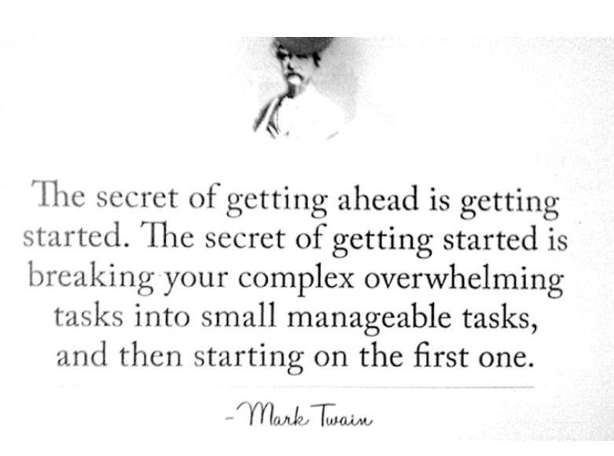

Slide 3
Definition of Scrum
Scrum (n): A framework within which people can address complex adaptive problems, while productively and creatively delivering products of the highest possible value.
Scrum is:
Lightweight
Simple to understand
Difficult to master

Slide 4
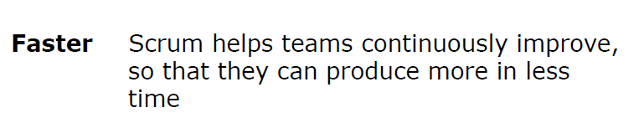
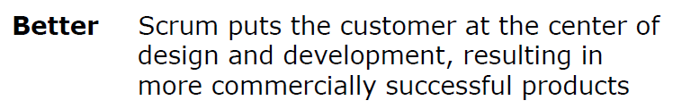
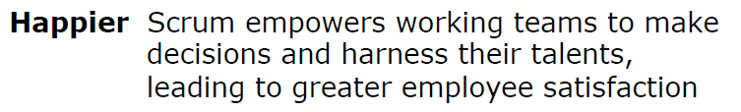

Scrum Supports Organization in 3 ways

Slide 5
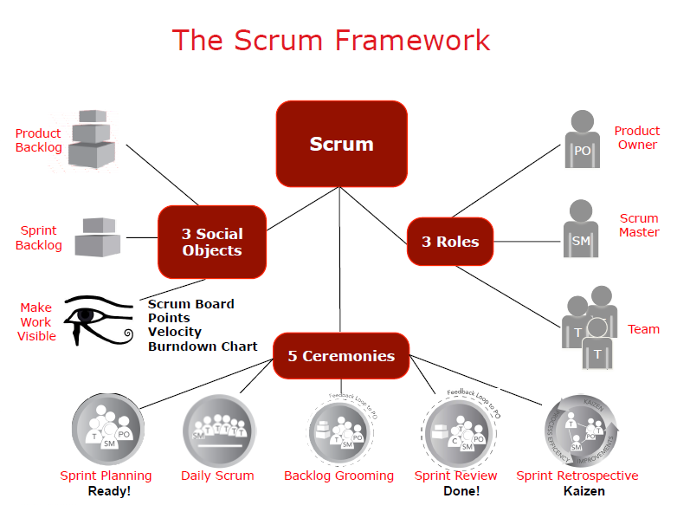
Scrum Framework

Slide 6
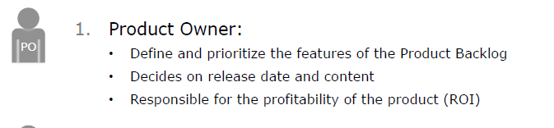
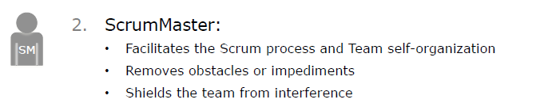
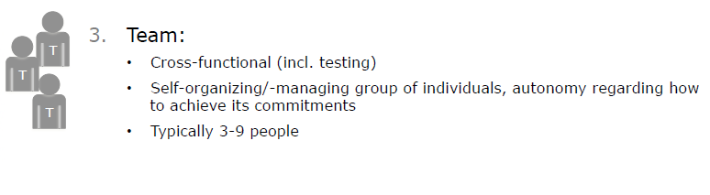
Scrum Roles

Slide 7
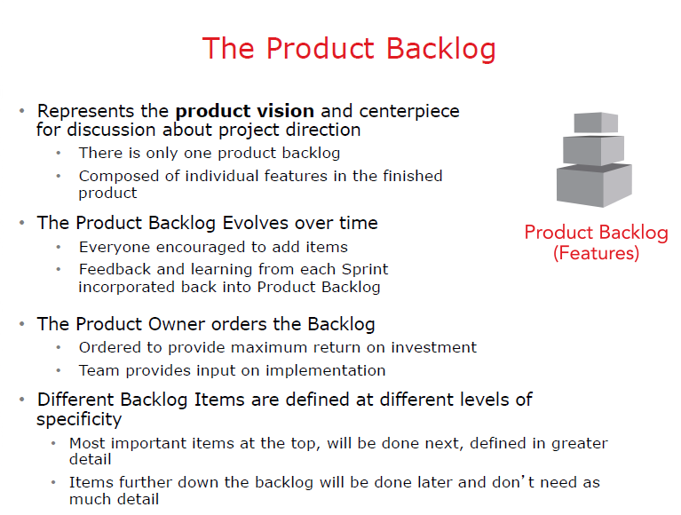
Product Backlog

Slide 8
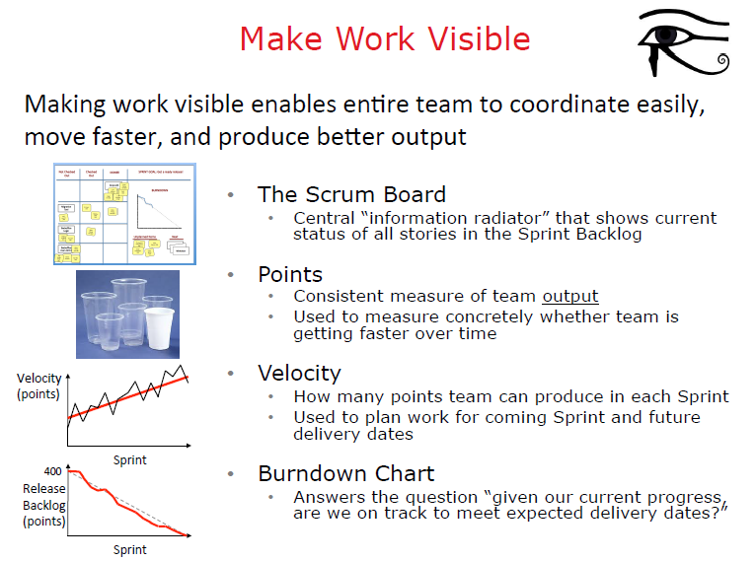
Work Visibility

Slide 9
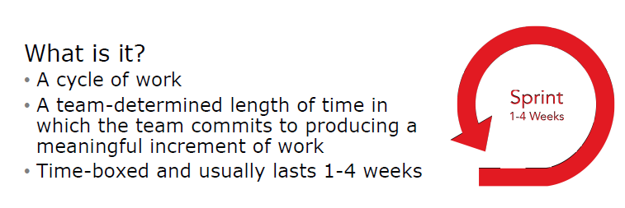
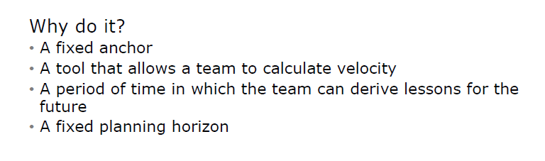
Sprint and Iterative work

Slide 10
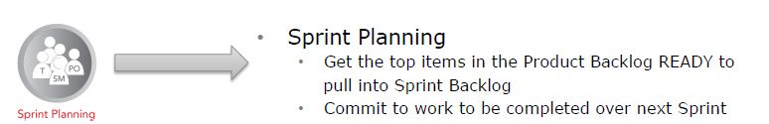
Five Scrum Meetings
Agree the sprint goal, a short description of what they are forecasting to deliver at the end of the sprint.
The recommended duration is four hours for a two-week sprint (pro-rata for other sprint durations)
During the first half, the whole scrum team (development team, scrum master, and product owner) selects the product backlog items they believe could be completed in that sprint
During the second half, the development team identifies the detailed work (tasks) required to complete those product backlog items; resulting in a confirmed sprint backlog
As the detailed work is elaborated, some product backlog items may be split or put back into the product backlog if the team no longer believes they can complete the required work in a single sprint

Slide 11
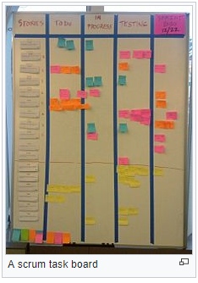
Five Scrum Meetings

Slide 12
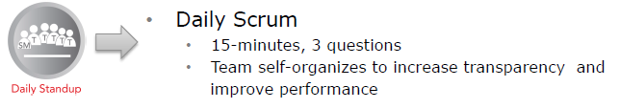
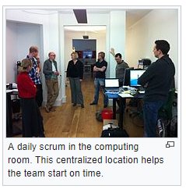
Five Scrum Meetings
During the daily scrum, each team member typically answers three questions:
What did I complete yesterday that contributed to the team meeting our sprint goal?
What do I plan to complete today to contribute to the team meeting our sprint goal?
Do I see any impediment that could prevent me or the team from meeting our sprint goal?

Slide 13
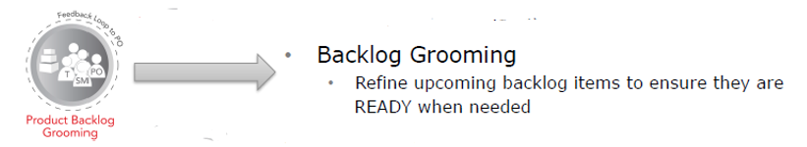
Five Scrum Meetings
Backlog refinement (formerly called grooming) is the ongoing process of reviewing product backlog items and checking that they are appropriately prepared and ordered in a way that makes them clear and executable for teams once they enter sprints via the sprint planning activity.
Product backlog items may be broken into multiple smaller ones. Acceptance criteria may be clarified. Dependencies may be identified and investigated.

Slide 14
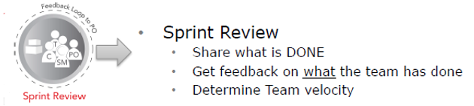
At the end of a sprint, the team holds two events: the sprint review and the sprint retrospective.
At the sprint review, the team:
Reviews the work that was completed and the planned work that was not completed
Presents the completed work to the stakeholders (a.k.a. the demo)
Collaborates with the stakeholders on what to work on next
Guidelines for sprint reviews:
Incomplete work cannot be demonstrated.
The recommended duration is two hours for a two-week sprint (proportional for other sprint-durations)

Slide 15
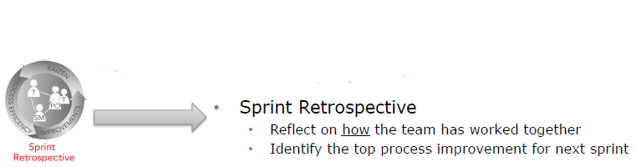
At the sprint retrospective, the team:
Reflects on the past sprint
Identifies and agrees on continuous process improvement actions
Guidelines for sprint retrospectives:
Three main questions are asked in the sprint retrospective: What went well during the sprint? What did not go well? What could be improved for better productivity in the next sprint?
The recommended duration is one-and-a-half hours for a two-week sprint (proportional for other sprint duration(s))
This event is facilitated by the scrum master

Slide 16
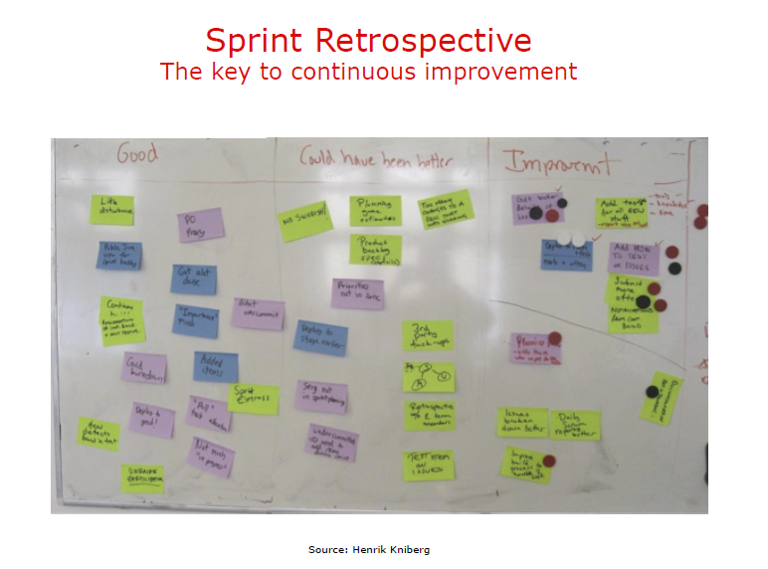
Sprint Retrospectives

Slide 17
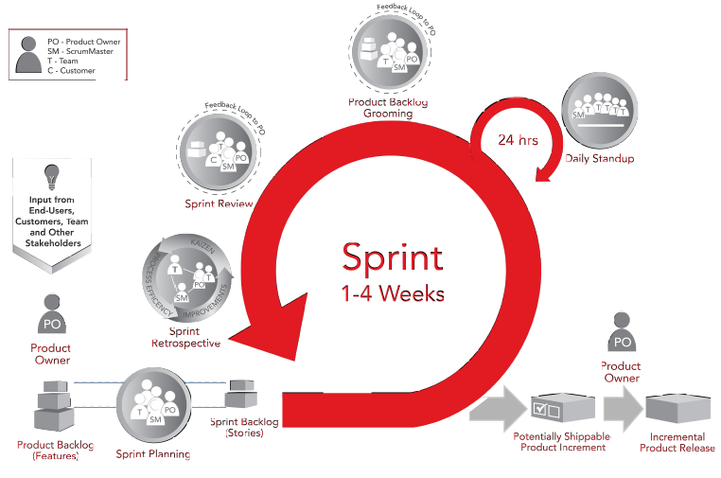
How Sprint Works

Slide 18
Why Sprint works

Slide 19
Why Sprint works

Slide 20

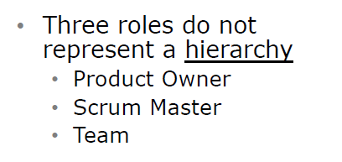

Slide 21



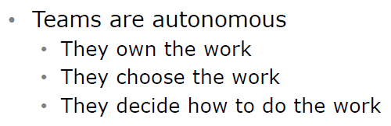

Slide 22



Slide 23
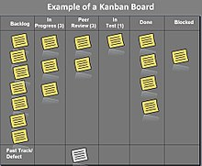
Kanban
Kanban (signboard or billboard) is a lean method to:
Manage and improve work across human systems.
Manage work by balancing demands with available capacity
And by Improving the handling of system-level bottlenecks.

Slide 24
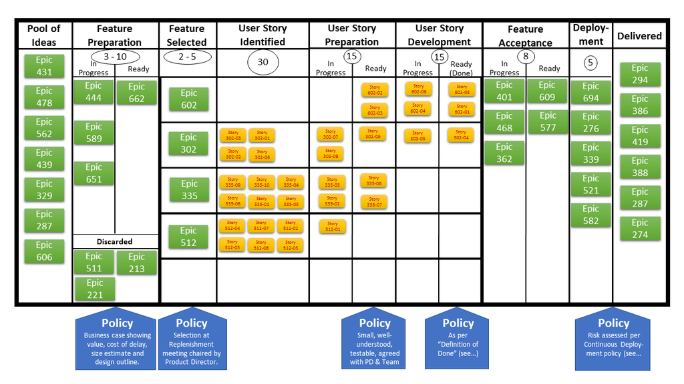
General Workflow and Kanban

Slide 25
Scrumban
Scrumban is a software production model based on Scrum and Kanban
Especially suited for product maintenance with frequent and unexpected work items, such as production defects or programming errors
To illustrate each stage of work, teams working in the same space often use post-it notes or a large whiteboard.[58] In the case of decentralized teams, stage-illustration software such as Assembla, JIRA or Agilo.
Major differences between scrum and Kanban is that in scrum work is divided into sprints that last a fixed amount of time, whereas in Kanban the flow of work is continuous

Slide 26
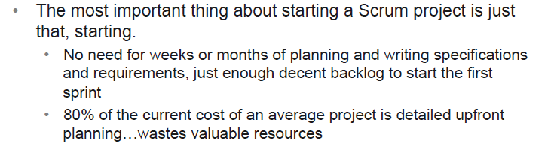
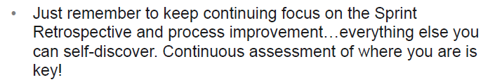
Just get started !!!

Slide 27
Reference and bibliography
https://www.scrumguides.org/docs/scrumguide/v2016/2016-Scrum-Guide-US.pdf
Pichler, Roman. Agile Product Management with Scrum: Creating Products that Customers Love. Upper Saddle River, NJ: Addison-Wesley, 2010
https://www.atlassian.com/agile/scrum/backlogs.
https://www.scrumalliance.org/learn-about-scrum/community-webinars/webinar-replays/scrum-fundamentals/the-role-of-the-product-owner
https://www.amazon.com/Essential-Scrum-Practical-Addison-Wesley-Signature/dp/0137043295
https://www.infoq.com/minibooks/kanban-scrum-minibook

